Slide 1

ECON 1BB3 – Introduction to Macroeconomics

Slide 2
Markets
market = group of buyers and sellers
there are 4 types of market structure:
1. perfect competition (buyers and sellers are price takers)
2. monopoly (1 seller-has the market power, ability to set the price)
3. oligopoly (only 1 buyer-i.e. national defence goods)
4. monopolistic competition (has many sellers, but the goods being sold are not identical to each other, i.e. Books, movies)
Notes:
Market is a collection of people, not actually a place.
Perfect Competition (extreme) → ice cream selling
Lots of buyers and sellers
Good sold is identical (i.e. corn, gold; corn grown in Iowa = corn from Canada → many buyers and sellers)
No power to set the price, buyers and sellers are price takers
2) Monopoly (extreme)
One seller in the market; they have certain power to set the price
Reason why there is only one seller can vary because there are forms of barriers to entry
i.e. Diamond’s company → they control 80-90% of all the diamonds in the world b/c they own most of the land where the diamonds are found = barrier to entry b/c not that many diamond sites in the world;
other barriers to entry = large infrastructures (i.e. delivering power to households; it is a public and not private service b/c it costs a lot of money to set up the network (transmitting energy to user is very complex process)
Some barriers to entry are legal = i.e. government-granted beer store; The Beer Store is the only place in Ontario to get beer; nothing to do with owning land of where supply are)
They are restrained by demand
Monopolies are somewhat advertised; they just want to increase demand overall. They are trying to increase demand on the whole (i.e. want people to buy diamonds)
Oligopoly: in b/w 2 extremes; few sellers/firms (i.e. OPEC, organization of petroleum exporting countries
4) Monopolistic competition: many sellers/firms but not selling a specific item (i.e. corn, wheat, iron, iron ore) → selling a slightly differentiated good (i.e. movies, books → lots of them, but each different)

Slide 3
Demand
Quantity Demanded (Q^{d}): the amount of a good that buyers are willing & able to purchase
the variables that influence how much buyers want to buy are:
1. price (as price increases, quantity demanded decreases)
2. income
      normal and inferior goods
3. price of other goods
      substitutes and complements
4. tastes
5. expectations
Notes:
Looking at perfect competition:
Quantity demanded:
Key word: ABLE. The amount of good that you want at the moment (i.e. Qd of Ferrari = zero)
Variables that influence the Qd:
*NOT NECESSITIES → variable b/w ppl
Price (increase in P, decrease Qd)
Income (higher I, increase Qd); goods can be classed as either normal when or inferior
(normal → increase I, increase Qd → most goods in society are normal; more goods bought with higher income)
(inferior → increase I, decrease Qd → kraft dinner, dollar store, or riding on GO Train, cheaper than driving; buying regular ground beef → more lean meat bought with higher income → inferior goods are goods bought b/c can’t afford similar goods that we want to buy (i.e. anything with low income and consuming that good)
3) Price of other goods (Starbucks coffee vs. Tim Hortons → substitutes; when price of A increases, Qd of A decreases, Qd of B increases; Coffee and sugar → complements = two things used together (ski and ski boots); price of A increases, Qd of A decreases, Qd of B decreases)
4) Tastes (i.e. could be personal preference or…i.e. there has been a decrease in demand for deli meat b/c of health problems → cut back on consumption
5) Expectations (if you expect something to happen in the future, you will change your behaviour now;
i.e. if expect the stock market to go down, you sell more now…if enough people respond the same way = P does go down
With expectations, people react to news before anything has actually changed
- Normal good: when income goes up we buy more of that good
Inferior good: good that when income goes up, the demand for it goes down (ex. Kraft dinner)
expectations: have to do with the expectation of the change of the price in the future that influences your decision/action today.
(ex. If you expect gas price to go up on Friday then on Tuesday you go and fill up the gas) → what happens to demand in Xmas, that’s expected (SEASONAL TASTE NOT EXPECTION) → expection is your expection on changes in price in the price in the future

Slide 4
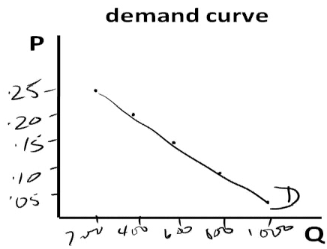
Demand
Law of Demand: other things equal (ceteris paribus), the quantity demanded of a good falls as the price of the good rises
demand schedule
demand curve
P | Q
.05 | 1000
.10 | 800
.15 | 600
.20 | 400
.25 | 200
Notes:
If assume income stays the same, prices of other goods same, and expectations and taste is same, if price of good goes up, people will buy less of that good.
Demand schedule is for HB pencils.
Price: independent variable
Demand: dependent variable

Slide 5
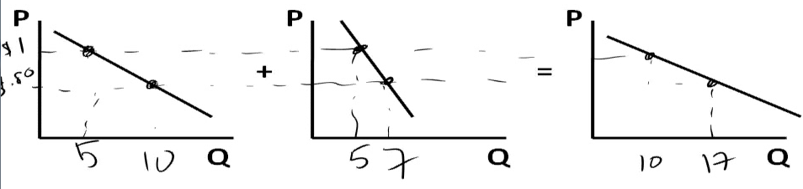
market demand: the horizontal sum of individual demands
Jane
Jeff
Market Demand
Notes:
Adding up the demand curves horziontally by determining what is the individual Qd at each P.

Slide 6
shifts in demand (change in demand) are caused by a change in anything other than price
movement along the demand curve (change in quantity demanded) is caused by a change in price
      if quantity increases, demand shifts OUT
      if quantity decreases, demand shifts IN
P
Increase in demand
Decrease in demand
Q
Notes:
Shift in demand factors:
Price (if P of Tim Hortons goes up, demand decreases???) → movement along curve
Income (if income goes up, demand increases) → shift curve
Prices of other goods → shift curve
Expectations → shift curve
Tastes → shift curve
Movement along demand factor:
Price
If income increases and good is normal, D increases and shifts out to the right.
If income decreases, and good is normal, D decreases and shifts in to the left

Slide 7

Prices will go up
ECON 1BB3 – Introduction to Macroeconomics
Notes:
If Wal-Mart workers unionize, they all get higher wages. Wal-mart will pass higher cost onto consumers

Slide 8
Supply
Quantity Supplied (Q^{s}): the amount of a good that sellers are willing and able to sell
the variables that influence how much sellers want to sell are:
1. price
2. input prices (i.e. Labour wages; if this goes up, supplies go down)
3. technology (tends to lower to cost thus increase the profit→ supply goes up)
4. expectations
Notes:
Price → hold everything constant except price. What is the firm going to do if price changes? A firm’s profits = Revenue – cost.
If price goes up, then the firm will want to sell more to earn more profit. If the price goes down, the firm would want to sell less to save themselves from losing profit.
Input prices → If input prices increase, profits would decrease, Qs would decrease
Technology → improvement in technology leads to using fewer inputs, increasing supply
4) Expectations → If prices will go up, save selling the goods now

Slide 9
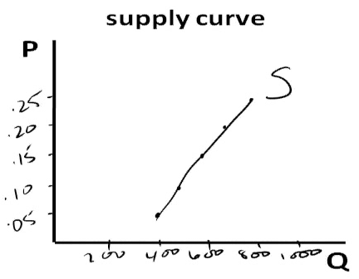
Supply
Law of Supply: other things equal (ceteris paribus), the quantity supplied of a good rises as the price of the good rises
supply schedule
P | Q
.05 | 400
.10 | 500
.15 | 600
.20 | 700
.25 | 800

Slide 10
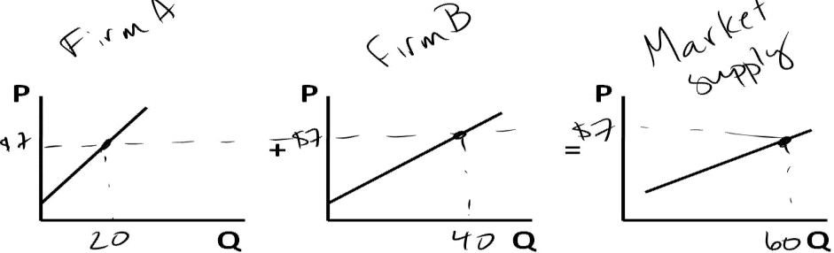
market supply: the sum of individual supply curves
Notes:
Horizontal sum of the individual supply curves.

Slide 11
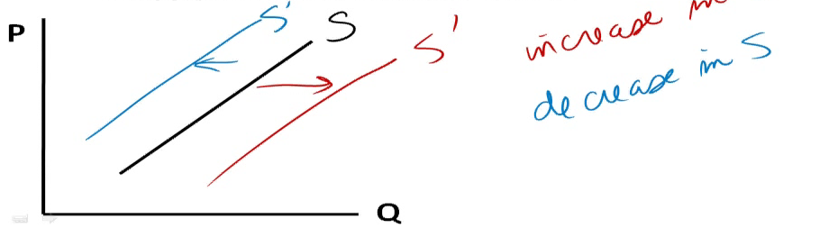
shifts in supply (change in supply) are caused by a change in anything other than price
movement along the supply curve (change in quantity supplied) is caused by a change in price
      if supply increases, the curve shifts OUT
      if supply decreases, the curve shifts IN
Notes:
Supply shifting:
Input prices
Technology
Expectations
Movement along the curve:
Price

Slide 12
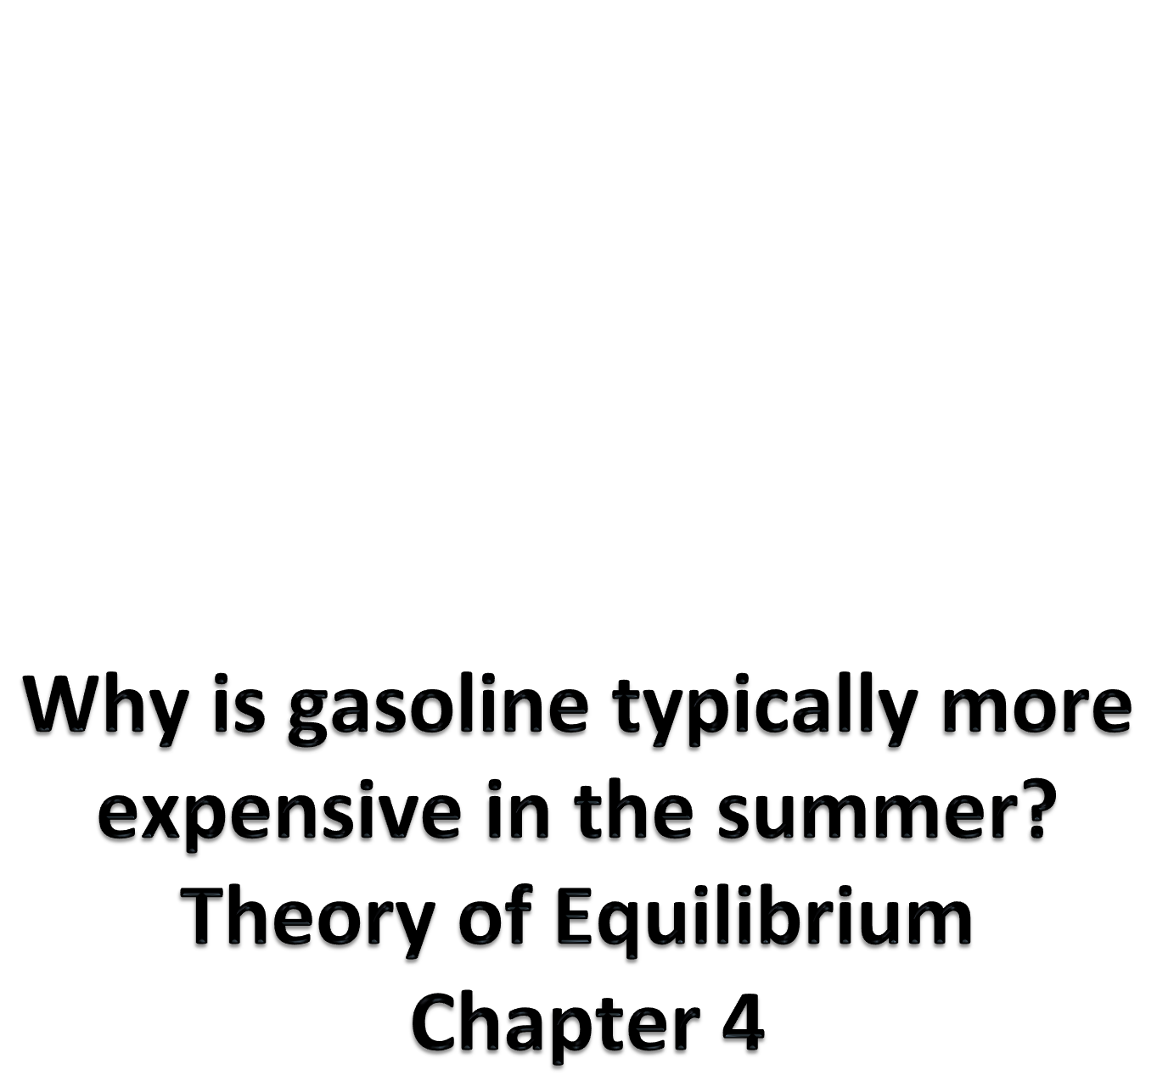
ECON 1BB3 – Introduction to Macroeconomics
Notes:
Are Qd and Qs stock (at a particularly point in time) or flow (per year, per week) variables?
→ B (supply can change over time, therefore flow)
Supply 5 ice creams PER WEEK
If you ask how many cars a plant makes, the manager would say they make ### in a year

Slide 13
Equilibrium
equilibrium price: the price for which Q^{s} = Q^{d}
equilibrium quantity: the quantity that corresponds to equilibrium price
P
Q
Notes:
Used for comparative statics → start at equilibirum then shock the system and one of the curves will shift and we will find a new equilibrium

Slide 14
If Q^{s} > Q^{d} there is a surplus
P
S
P^
Surplus/excess supply
D
Q
Stocks build up and firms decrease price until
equilibrium is restored
Notes:
Firms are producing more than households are willing to purchase
Qd and Qs are FLOW variables. The quantity of ice cream produced in a week and the quantity of ice cream demanded in a week are flow variables.
What happens when flow of goods produced is greater than the flow of goods purchased? Over time, stocks will build up and because expensive for firms to store goods that no one is buying; firms will have to rent warehouse space in order to keep all extra products no one is buying. If decrease price, people will buy the goods.
Price keeps falling until equilibrium is restored

Slide 15
If Q^{s} < Q^{d} there is a shortage
P
S
Shortage/excess demand
D
Q
People line up, firms increase price and sell more
until equilibrium is restored
Notes:
People are demanding more than firms are producing.
Shortage = excess demand. (i.e. tickets to a concert/game, etc. there are fixed number of seats available and people are willing to pay a lot to get the seats; there is an upward pressure on the price). This upward pressure on price would stop until Qs = Qd
Arenas and stadiums are good example of shortages because the supply is fixed and excess demand exists
High prices → production cost is high or demand is low (surplus)
Low prices → produiction cost Is low or demand is high (shortage)

Slide 16
3 steps for analyzing changes in equilibrium [COMPARATIVE STATICS]
1. Decide whether the event shifts the supply or demand curve (or perhaps both)
2. Decide in which direction the curve shifts (in or out)
3. Use the supply-and-demand diagram to see how the shift changes the equilibrium price and quantity
We will use this program for several examples in the market for HB pencils.
Notes:
Comparative b/c looking at initial equilibrium and final. Statics b/c don’t care how from initial to new point.
There will be an equilibrium → then a “SHOCK TO THE SYSTEM”/event will occur that will change either demand or supply
In rare cases is that both shift (1/100).
→ rarely does one shock cause both curves to shift (factors that cause demand and supply curve are different, so one factor only shifts one curve)

Slide 17
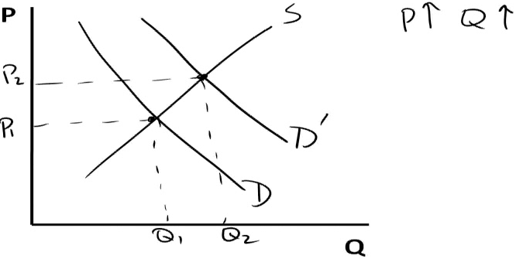
Examples
consumer income
(pencils are normal goods)

Slide 18
Examples
2. there is an in use of MC type tests
P
S
D
Q
Notes:
Firms produce more pencils but it is a movement along the supply curve…NOT a shift in the supply curve.
Usually when one change = only one shock.
Figure out if shock affects buyers behavior or producers behavior.
Qd will change if the S curve shifts
Qs will change if the D curve shifts
COMPLEMENT (u use pencils with tests)
More pencils are produced (nothing on the supple side has change) → quantity supply changes, but no change in supply

Slide 19
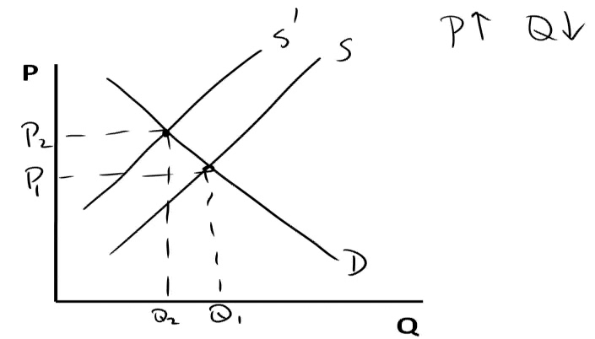
Examples
3. in the price of graphite
P
S
D
Q

Slide 20
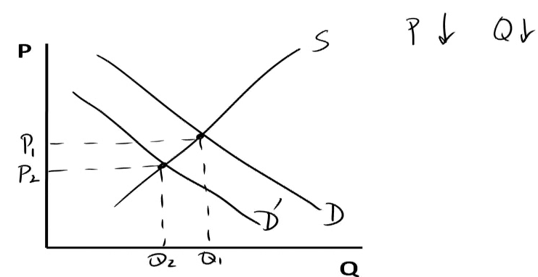
Examples
4. in the price of ink pens (this affects the Demand curve, demand decreases)
P
S
D
Q
Notes:
On the test, have to write P decreases, quantity decreases
SUBSTITUTE good

Slide 21
Examples
5. the school year starts
P
S
D
Q
Notes:
They making more pencils becaues ppl want to buy pencils not because of cost of production like labour (ceteris paribus)

Slide 22
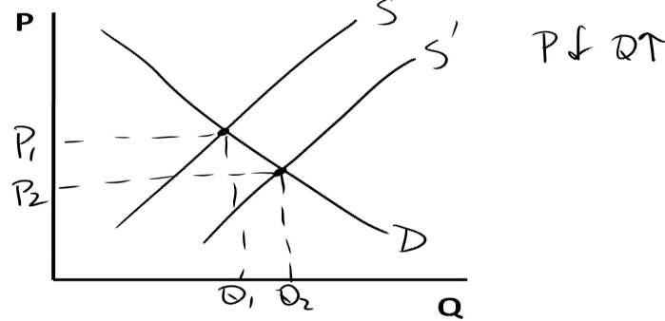
Examples
6. new technology lowers the cost of producing pencils
P
S
D
Q

Slide 23
We know that the price of pencils has fallen due to new tech or decrease in price of ink. How would we know which was the cause of the lower price?
If eq quantity of pencils increased, it must be technology

Slide 24
Examples
6. new technology lowers the cost of producing pencils and there is a decrease in price of ink pens
P
S
D
Q
Notes:
Price goes down but Quantity changing, and it is ambiguous
look at the table in the book but do not attempt to memorize

